Slide 1

Autonetics and Administration for IT Laboratories
Group No. 17
Uddhabendra Maity | 16104062
Karthikeyan | 16104050
Atharv Shetty | 16104061
Guide: Dr. Sameer Nanivadekar Co-Guide: Prof. Vishal Badgujar

Slide 2
Contents
Abstract
Introduction
Objectives
Literature Review
Problem Definition
Existing System Architecture/Working
Proposed System Architecture/Working
Technological Stack
Scope
Limitations
Conclusion
References

Slide 3
Abstract
Often it is observed that many of the PC's are remained switched on even when the labs are not in use resulting in an inefficient use of power and resources. Also the PCs have to be manually switched off by the lab assistants after the end of lab sessions if the students haven't shut it down themselves.A powerful,systematical and efficient Lab management system is required which will resolve all these basic and generic problems with less human labor.In our case, the Ansible tool which was developed to simplify complex orchestration and configuration management tasks has been chosen.

Slide 4
Introduction
●
In the faculty’s premises, a large number of computer classrooms is used for the teaching and research.
●
However, some settings and applications are common to all of these cases. We developed a scenario that would unify the administration of such classrooms and save considerable amount of time spent on the maintenance of these classrooms.
●
An Online Registry for each lab would be maintained in the proper GUI software which will carry the details of each and every student who have logged in to the individual PCs instead of passing the regular Lab Registers from place to place and updating the register manually for each session.

Slide 5
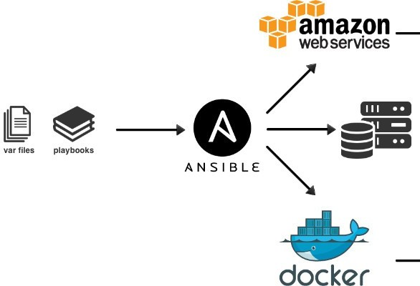
Ansible integration with other services

Slide 6
Objectives
To Automate the Software installation process. To Automate the PC shutdowns
To regulate the user identity of every PC along with time in a digital format
To alert the users about the remaining time of the current lab session
●
●
●
●
●
A proper GUI will be created which will display the
announcements
To unleash the full potential of Ansible for IT automation
To remotely control the electrical appliances of the whole Lab.
important
●
●
.

Slide 7
Literature Review
Paper title: Automated Delivery in Pro NuGet
Authors: M. Balliauw and X. Decoster
Findings: In this paper, they have tried automating the labs using network interfacing
Advantages: Effective Package Management
Disadvantages: High Bandwidth Consumption,Client-Server node Failure leads to catastrophic issues.

Slide 8
Literature Review
Paper title: Topology and orchestration specification for cloud applications (TOSCA)
Authors: D. Palma and T. Spatzier
Findings: In this paper, they had implemented automating the labs by Management using Cloud Computing With cloud based applications.
Advantages:Does not mandate the use of any specific security mechanism or technology
Disadvantages: Expensive Infrastructure and maintenance for small Areas.

Slide 9
Literature Review
Paper title: Unleashing Full Potential of Ansible Framework: University Labs Administration
Authors: Pavel MasekMartin ŠtůsekJan Krejčí
Findings: In this paper, the developers have tried to create an ansible based environment for lab administration using various playbooks.
Advantages: Performs better than the previous generation technologies and is flexible and scalable to large extent
Disadvantages: Limited to the capabilites of the Ansible framework. They have developed the project completely depending on the ansible framework.

Slide 10
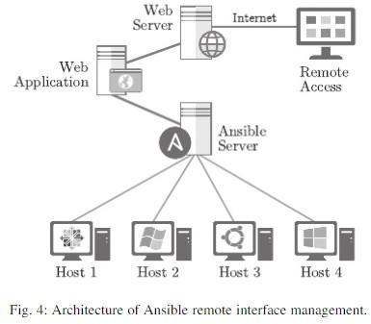
Existing Architecture of Ansible Remote Interface

Slide 11
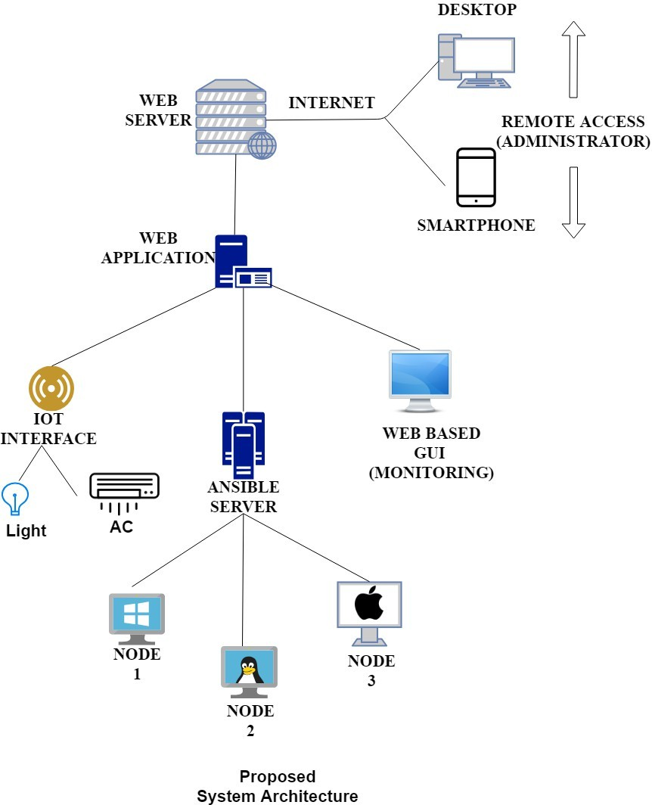
Proposed Architecture

Slide 12
Problem Definition
●
In current labs of university most of the administrative work is done manually which consumes lot of time and efforts.
●
With the help of Ansible framework and a proper supporting GUI which can unleash and maxmise the full potential of the servers,many of the current lab administrative problems can be resolved.

Slide 13
Technological Stack
Hosting : Ansible Web Server
Nodes: Linux Ubuntu,Windows
Front End : Python,Java , Android Studio, HTML5 , Axure RP
Database : MariaDB

Slide 14
Scope
The expected system will ease the whole autonetical process in labs and make the administration more easier.
This is completely an open source project and thus the total outcome expenditure is very low. Due to this, even the universities in the rural areas can claim benefit out of this.
The GUI will have a tutorial at the beginning for the lab handlers.
The proposed system will be the future of lab automation for university labs.

Slide 15
Limitations
●
Primary Focus- Lab administration: Automation of Electrical appliances as per the seating arrangement in the lab can be implemented in future
●
No involvement of Cloud infrastructure : Since the cloud infrastructure is entirely owned, managed and monitored by the service provider, it transfers minimal control over to the customer.
●
Totally depends on the inter-connectivity of PCs with the host PC: Thus any loose connection or wire mismanagement may affect the functioning of the nodes.

Slide 16
Conclusion
➢
By going through the previous surveys and IEEE papers we,ve listed all the current problems in the university labs and found out the solutions to minimize the workload for the lab assistants and faculty members to the maximum.
➢
Using Ansible network along with other supporting tools and a proper GUI interface as a single unit would benefit the whole lab and the labs can be converted into current gen modern labs which will work up to the industry standards.

Slide 17
Conclusion
➢
By going through the previous surveys and IEEE papers we,ve listed all the current problems in the university labs and found out the solutions to minimize the workload for the lab assistants and faculty members to the maximum.
➢
Using Ansible network along with other supporting tools and a proper GUI interface as a single unit would benefit the whole lab and the labs can be converted into current gen modern labs which will work up to the industry standards.

Slide 18
References
Pavel MasekMartin ŠtůsekJan Krejčí, “Unleashing Full Potential of Ansible Framework: University Labs Administration” May 2018
Nishant Kumar Singh ,Amity University,”Automated Provisioning of Application” June 2017
J. O. Benson, J. J. Prevost, and P. Rad, “Survey of automated software deployment for computational and engineering research,” in System Conference (SysCon), 2016 Annual IEEE, pp. 1–6, IEEE, 2016.

